Slide 1

How does it work?
Gboard
Baasit Sharief (baasitsh@buffalo.edu)
CSE 705
June 15th, 2022

Slide 2
Background

Slide 3
Gboard
Released in 2016
Introduced Glide Typing, Predictions and Autocorrections etc
Search and send from Gboard without opening the chrome app
Works with more than 100 languages
Multilingual transliteration - type in one language according to pronunciation and return in the other language
Speech-to-Text feature as well

Slide 4
Before we move and talk about ML in Gboard
How many of these features do you think use ML?

Slide 5
Before we move and talk about ML in Gboard
How many of these features use ML?
Speech-to-Text
Glide Typing
Transliteration
Predictive Text
Smart-Text Replies

Slide 6
ML in Gboard

Slide 7
Sequence Modeling with CTC (distill.pub)

Slide 8
Speech-To-Text
Older methods used waveforms spoken by a user split into small consecutive slices or “frames” of 10 milliseconds of audio
Each frame was analyzed and the corresponding feature vector was passed into a GMM or DNN that outputs a probability distribution over all the phonemes (sounds) in the model
Pronunciation Model that links sequences of sounds to valid words in the target language and a Language Model that expresses how likely given word sequences are in that language is then used to predict the said words
If the user speaks the word “museum” for example - /m j u z i @ m/ in phonetic notation - it may be hard to tell where the /j/ sound ends and where the /u/ starts, but in truth the recognizer doesn’t care where exactly that transition happens: All it cares about is that these sounds were spoken.

Slide 9
Speech-to-Text
Currently uses LSTM based sequence model
Recognize phonemes in an utterance without requiring them to make a prediction for each time instant
Trained to output a sequence of “spikes” that reveals the sequence of sounds in the waveform with the help of Connectionist Temporal Classification objective
Artificial noise and reverberation to the training data, making the recognizer more robust to ambient noise
The spikes predicted to refer to phonemes which are considered the smallest unit of speech

Slide 10
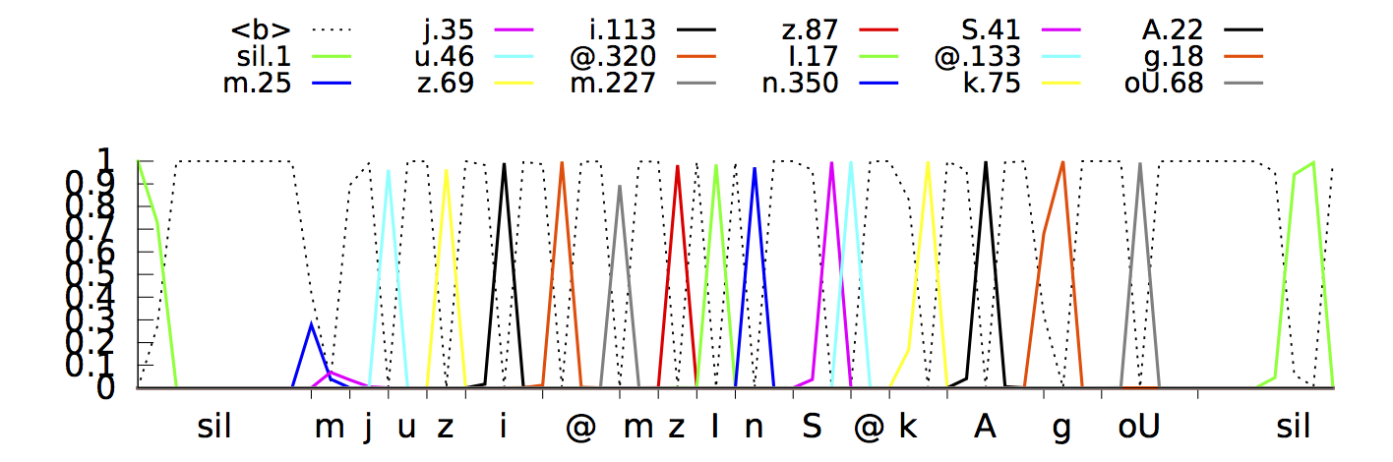
Speech-To-Text
The CTC recognizer outputs spikes as it identifies various phonetic units (in various colors) in the input speech signal. The x-axis shows the acoustic input timing for phonemes and y-axis shows the posterior probabilities as predicted by the neural network. The dotted line shows where the model chooses not to output a phoneme.

Slide 11
Glide Typing

Slide 12
Glide Typing
Subject to errors that are generally attributed to “fat finger typing”
Along with cognitive and motor errors
A keyboard should account for these errors and predict the intended words
Rapidly
Accurately

Slide 13
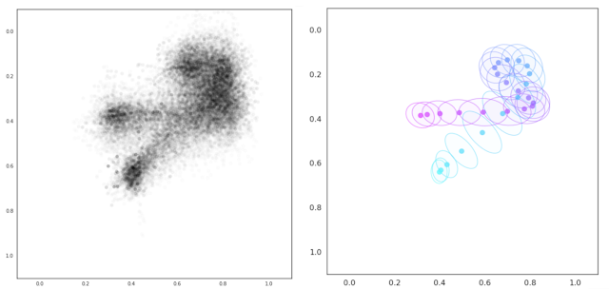
Glide Typing
Previously used a Gaussian model to quantify the probability of tapping neighboring keys
Rule-based model to represent cognitive and motor errors
Currently uses and LSTM model with Connectionist Temporal Classification criteria to train based on their experience of acoustic voice search
More complicated than voice search
one cannot easily transcribe millions of touch point sequences and glide traces
exploited user-interaction signals, e.g. reverted auto-corrections and suggestion picks as negative and positive semi-supervised learning signals, to form rich training and test sets
Tensorflow was used to train models over JAX/FLAX which is their goto for research
Raw data points corresponding to the word “could” (left), and normalized sampled trajectory with per-sample variances (right).

Slide 14
Finite-State Transducers
lexicon tells us what words occur in a language and a probabilistic grammar tells us what words are likely to follow other words
FSTs are used to encode this information
Provide a principled way to represent various probabilistic models (lexicons, grammars, normalizers, etc)
Together with the mathematical framework needed to manipulate, optimize, combine and search the models
Probabilistic n-gram transducer is used to represent the language model for the keyboard combined with a Beam Search

Slide 15
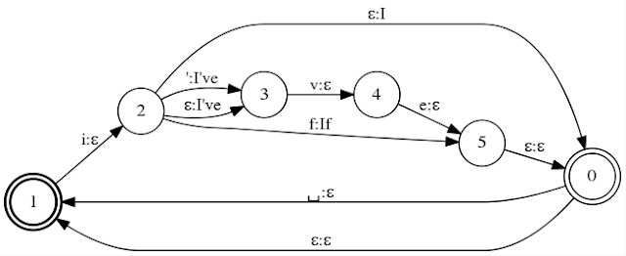
Finite-State Transducers
This transducer encodes “I”, “I’ve”, “If” along paths from the start state (the bold circle 1) to final states (the double circle states 0 and 1). Each arc is labeled with an input key (before the “:”) and a corresponding output word (after the “:”) where ε encodes the empty symbol. The apostrophe in “I’ve” can be omitted. The user may skip the space bar sometimes. To account for that, the space key transition between words in the transducer is optional. The ε and space back arcs allow accepting more than one word.

Slide 16
Transliteration
Languages with complex scripts, romanization systems have been developed to map characters into the Latin alphabet, often according to their phonetic pronunciations
With the help of an FST, transliterations for languages like Hindi is just a simple extension of the generic decoder

Slide 17
Predictive Text
Users based on their typing history
Matching the most appropriate phrases in the language in which the user has been typing
Is a sequence modelling problem
Predictive text involve predicting next word/phrase
Currently uses LSTM, since transformer architectures are very heavy for Edge devices like Mobile phones
Beam Search to get outputs

Slide 18
Smart-Text
Based on the message, predict the best possible reply
Provides generic responses
Uses LSTM based architecture
Trained on conversations corpus
Objective is very similar to predictive text only difference being two different speakers to be modeled into inputs to ensure correct predictions
Beam search to determine the output and it’s length

Slide 19
References
LSTM-Based RNN Architectures For Large Vocabulary Speech Recognition
Google AI Blog: The Machine Intelligence Behind Gboard (googleblog.com)
Google AI Blog: Google voice search: faster and more accurate (googleblog.com)
Sequence Modeling with CTC (distill.pub)

Slide 20
Questions

Slide 21
Thank You!

